Slide 1

Software Test Automation for High Quality Software
VectorCAST Workflow Training

Slide 2
Company Overview
VectorCAST Training Materials Copyright Information
All training materials for this class is the intellectual property of Vector North America and is used as part of Vector North America’s VectorCAST training classes. Reproduction is prohibited either electronic or mechanical without the expressed written consent of Vector North America. Any questions or comments regarding the training materials presented for this class please contact the training manager at 248-504-6443 or email training@us.vector.com.
VectorCAST training materials include:
VectorCAST_Workflow_Training_AllInOne.pdf
VectorCAST_Workflow_Training_ExercisesOnly.pdf
Training.zip containing the source code and working folders.
vector-DEMO.lic

Slide 3

Company Overview
Vector Worldwide
USA Detroit, East Greenwich, San Mateo
France Paris, Toulouse
Germany Stuttgart, Brunswick, Hamburg, Karlsruhe, Kempen, Munich, Regensburg
159 employees
49 employees
2,287 employees
Foundation 1997
Foundation 2002
Foundation 1988
Great Britain Birmingham, London
Sweden Gothenburg, Linköping
39 employees
93 employees
Foundation 2009
Foundation 2002
Japan
Tokyo, Nagoya, Osaka 138 employees
Foundation 1998
Italy Milano
India Pune, Bangalore
Korea Seoul
11 employees
109 employees
70 employees
Foundation 2014
Foundation 2009
Foundation 2007
Austria Vienna
38 employees
Vector Group
3,144 employees
Date: April 2020
Foundation 2013
Brazil São Paulo
Romania Timisoara
China Shanghai, Beijing, Shenzhen
4 employees
1 employee
146 employees
Foundation
Foundation 2014
Foundation 2019
Foundation 2009
Copyright: The World Factbook
Notes:
1
By clicking on the grey button the founding years are displayed
By clicking on the grey button the founding years are displayed
We try to locate offices near where our customers are for quicker response to our customers
North America has 150 employees spread across 2 office locations

Slide 4
Company Overview
Your Local Sales Team
Sales Account Mgr: email_address@vector.com
Field Application Engineer: email_address@vector.com
Foundation
Notes:
1
This slide is hidden, but it may be a good idea to show this slide and put in the contact info for the local sales team.

Slide 5


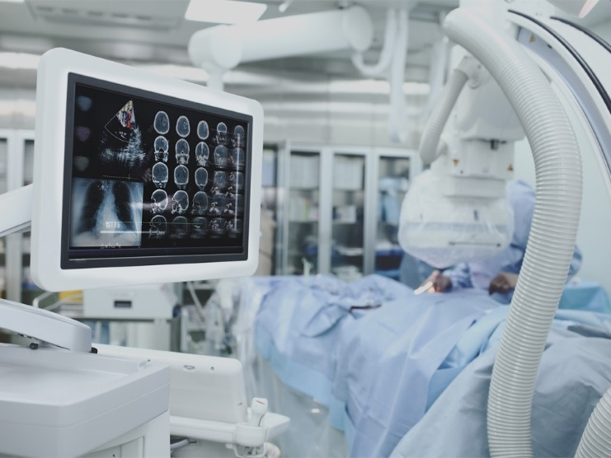
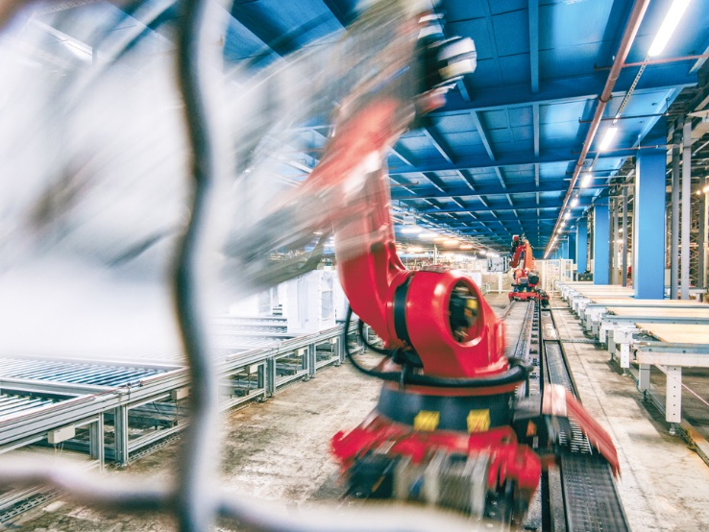


Company Overview
Industries
Aerospace
Automotive
Medical
Industrial
Railway
Business critical
Notes:
We offer services and solutions across a wide range of industries.

Slide 6




Company Overview
VectorCAST at a Glance
First product released in 1992 for Lockheed Martin’s C-130J Super Hercules
Integrated with 300+ compiler and target combinations
Solutions for: automotive, aerospace, medical, rail, industrial controls, and IoT
TÜV SÜD Certified: Software Tool for Safety Related Development
Acquired by Vector Group in 2017

Slide 7
Company Overview
Where VectorCAST Fits In Your Development Process
Requirements Specification
System
Testing
Architecture
Integration Testing
System
Design
Unit
Testing
Coding
Notes:
The product portfolio has features and options that help you throughout your development process.
Continuous integration helps to make sure your product maintains high quality throughout development.
On the left side of the V, VectorCAST integrates with other tools you have in your development environment.
VectorCAST products reside on the bottom and right side of the V where testing takes place.
VectorCAST encourages a Correct, Complete Continuous approach to software testing.
Correct: Code correctness is the basis for high integrity (safety critical) software
Complete: Vector offers tools to support ALL your testing – not just your software testing. And it supports thoroughness of your testing.
Continuous: Testing should be done early and often and VectorCAST supports that through automation, dashboards, and integrations with tools like Jenkins.

Slide 8
Company Overview
How VectorCAST Helps Your Project
ALM
Requirements Gateway
Analysis
Metrics Reporting
Model-Based
Development
Parallel
Testing
VectorCAST
Continuous
Integration
Static
Analysis
System Test
Code Coverage
Unit Test
Compiler, Debugger,
RTOS, Simulator
Technical Debt
Legacy Testing
Notes:
If we identify all the VectorCAST features they break down into these functional areas.
These are the types of features you can add into your development and test process.
(Use this slide to click on any area the customer wants to learn more about.)
Unit Test
Eliminates the need to manually generate thousands of lines of test code to support low level software testing
Easy to build test cases for correctness assessment and defect tracking analysis
System Test
Automation of your existing high level tests
Impact of Change reporting and execution to determine what tests need to be rerun after a code change
Code Coverage
Assesses thoroughness of testing across the lifecycle
Satisfies all safety critical standards
Continuous Integration
Ensures regression errors aren’t introduced as code changes
Greatly speeds the time between code change and code test
Compiler, Debugger, RTOS, Simulator
Integrates with hundreds of compiler / chip combinations
Deep domain expertise by our engineers
Technical Debt, Legacy Testing
Using VectorCAST to baseline existing code behavior in order to ensure future code changes don’t alter behavior
Metrics for legacy code to identify software quality risk areas that need further testing
Static Analysis
Understanding how code meets coding standards like MISRA

Slide 9
Company Overview
Technical Information and Support
Resource | Link
Vector Main Website | https://www.vector.com
Support | support@vector.com OR support@<CountryCode>.vector.com (IE: support@us.vector.com)
Events | https://www.vector.com/int/en/events/overview/
Knowledge Base | https://kb.vector.com/
YouTube | https://www.youtube.com/user/vectorchannel
LinkedIn | https://www.linkedin.com/company/vector-north-america

Slide 10
VectorCAST
Workflow Training Overview

Slide 11
VectorCAST Workflow Overview
Training Structure
Training Structure
Multiple Modules
Module Format
15-20 minutes of lecture with slides
20-30 minutes of exercises
1 or 2 quiz questions
Training Deliverables (zip file should be on your machine)
VectorCAST Product Installation Package
VectorCAST Evaluation License Key
PDF File which contains all of the Training Slides
Source Code and Test Scripts For Exercises
Let’s Go!
Install VectorCAST
Verify the License
Start VectorCAST

Slide 12
VectorCAST Workflow Overview
Training Agenda
Module 1
Workflow Preparation
Module 2
VectorCAST C/C++ Workflow
Module 3
VectorCAST QA
Module 4
Configuration Management
Module 5
Continuous integration

Slide 13
VectorCAST Workflow Overview
Why Use an Automated Test Tool
Test without writing any test code
Sophisticated Test Case Editor
Sophisticated Code Coverage Viewer
Tool Qualification Materials
Avionics: RTCA DO 178B / C
Automotive: ISO-26262
Medical: U.S. FDA
Process Control: IEC-61508
Railway: EN-50128
Built-in Regression Testing
Caveat: Using VectorCAST is more work than not testing!

Slide 14
VectorCAST Workflow Overview
Methods and Prerequisites
VectorCAST parallels manual method of testing
Processes in manual testing are automated with VectorCAST:
VectorCAST QA
Instruments entire application
Automate build of instrumented code
Automate execution of test scripts and manual procedures
VectorCAST C/C++
Building Test Code
Constructing Test Cases
Executing Tests
Building Test Documentation
The following must be present:
Compiler (on path)
Code Under Test Which Compiles
Notes:
If you can figure out how to test something manually, we can help you figure out how to do the test with VectorCAST
Compiler must be on your path before starting VC
Open a shell, type compile command, is the command found?
For C the UUT must compile, that means all of the headers must be available
For Ada, the UUT spec and body must compile, that means all of the dependent specs must also be available and compile. We DO NOT Stub specs!!

Slide 15
VectorCAST Workflow Overview
Comparing VectorCAST Workflow and C/C++ Training
VectorCAST C/C++ Training
How to use the tools supplied with VectorCAST
Create Unit Test Environments
Simple, Compound and Basis Path Test Cases
Environment, Test Case and Parameter User Code
Create System Test Environments
Instrument Source Code
Collect Coverage Data
Probe Points, Requirements Gateway, Cover By Analysis, CSV Import
VectorCAST Workflow Training
How to implement VectorCAST
From Nothing to Something
Create Testing Solution from Beginning to End
VectorCAST Start-up Scripts
Collecting Build Information
Set Up Complete Working Solution
Implement with Your Project
Notes:
VectorCAST C/C++ training teaches you how to use VectorCAST
VectorCAST Workflow training teaches you how to implement into a project.

Slide 16
VectorCAST Workflow Overview
Terminology
Unit | A C/C++ source-code file (*.c / .cpp), or an Ada Package
Unit Under Test (UUT) | A Unit containing functions that will be tested
Visible Subprograms Function Under Test | Subprograms, or Functions, in the UUT that are Testable Function, or Visual Subprogram, that is currently being tested (FUT)
Dependent Unit | A Unit containing subprograms used/called by a UUT
Stubs | Alternate unit logic for Dependent Units to allow control of data passed back to the UUT
Test Driver | Main program to exercise Visible Subprograms in the UUT
Test Harness | Executable program created when the Test Driver, Dependent Units, Stubs, and UUTs are linked together
Test Case | Collection of input data to stimulate the UUT and expected data to be compared against the outputs of the UUT
Blackbox | Test harness has no visibility into the internal structure of the UUT
Whitebox Instrumentation | Test harness has visibility into the internal structure of UUT Code added to your source code by VectorCAST to keep track of what statements and branches have been executed
Notes:
Just go through these, the definitions build on each other.

Slide 17
VectorCAST Workflow Overview
Unit Testing
This style of testing isolates an individual function or procedure of an application and ensures that the unit behaves as designed.
Units are the smallest testable part of any software
Usually at the function level but modules can be tested as well
Stubs assist in unit testing
Control input
Expected values on parameters

Slide 18
VectorCAST Workflow Overview
System Testing
Often referred to as integration testing, V&V, or application testing, this style of testing is characterized by its focus on executing and evaluating a standalone application (i.e. one that can be built independent of the test tool).
Tests are run against a complete “system”
As opposed to the component-level focus used with unit testing
The code under test is a standalone binary
Not wrapped by a “test harness” (as in unit testing)
However, the binary under test can be anything – even 3rd party unit tests

Slide 19
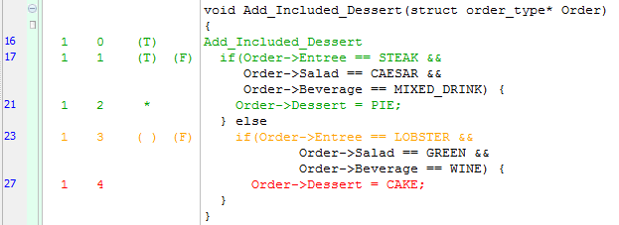
VectorCAST Workflow Overview
Code Coverage
Answers the question: “When I ran my code, what actually executed?”
Identifies gaps in test coverage
Each result shows what occurred during one run
Multiple runs aggregate to show overall coverage
Coverage is NOT proof that the code is correct!
Good test pass/fail criteria show correctness.

Slide 20
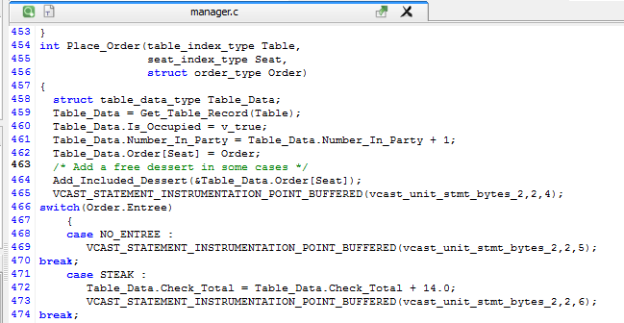
Instrumentation
Instrumentation Concept:
Like inserting: printf(“Executed line NNN”); throughout source
Actual Concept:
Optimized, space-efficient bitfield flags. 0 → 1 on exec.
Output can be done immediately or buffered for later retrieval

Slide 21
VectorCAST Workflow Overview
VectorCAST Unit Test Build Process
uut.cpp
uut.cpp
Parse
Harness Files
Harness Files
Instrument
Instrumented Harness Files
Instrumented Harness Files
Compile & Link
Harness Executable
Range Check
Harness Executable
Notes:
Cutting out some of the detail here, but this diagram represents the build process at a high level of detail. Note that the Range Test is not really a “build” step, but rather an execution step, but still, it’s part of the build process.

Slide 22
VectorCAST Workflow Overview
Range Check
A range check is a check to make sure a number is within a certain range.
Ensures a value assigned to a 16-bit unsigned integer is within the capacity of a 16-bit unsigned integer (i.e. checking against wrap-around).
Range is 0-65535
VectorCAST provides for full range checking of test data during test case building.
Three options that affect range check:
All (default) – Out of range values cannot be entered on any data type
Disable – Out of range values are not enforced in test case editor
Wrap around occurs
None – Scalar ranges are not determined
Increases execution speed
Notes:
A range check is completed at the end of an environment build.
VectorCAST provides for full range checking of test data during test cases building.
There are three options that affect how the range check is enforced during test case building
All (default) - VectorCAST will not allow an out of range value to be entered on any data type in the test case editor
Disable – When range checking is disabled, the dialog boxes will still show you the data range that is allowed, but will not enforce that range. This will allow you to enter values that are beyond the data range for the particular parameter or object (including enumerated values).
None - Similar to “Disable” with the added restriction that VectorCAST will not attempt to determine scalar ranges. The “None” option is normally used in target testing where execution speed is an issue.

Slide 23
VectorCAST Workflow Overview
VectorCAST System Test Build Process
Application Source
Parse
Instrumented Application Source
Application Build Command
Instrumented Application Executable
Notes:
This slide is to iterate that VectorCAST QA is not part of the build process.

Slide 24
VectorCAST Workflow Overview
Getting Help … Use the Help Menu
User Guides
PDF and HTML Versions
Licensing User Guide
Release Notes
Built-in Trace and Diagnostic Features
Example Environments
Pre-packaged examples to guide you through more advanced topics
Web Links for Downloading Products, Support etc.
North America Support email: support@vectorcast.com
Europe Support email: eu_support@vectorcast.com
Rest-of-World Support email: support@vectorcast.com
Notes:
Can show these items on the real GUI menu …
Getting Started User Guide has detailed step-by-step tutorials for all products
We will get into more detail about the Diagnostic Item Later in the Class
Example environments are available for C/C++ and use the built-in MinGW compiler
If you email to support, you will get an auto response with a case number, the email will also have a link for you to check the case status

Slide 25

VectorCAST Workflow Overview
Lua Source Code
Lua Source Code used as source base for lab exercises.
Lua is an open source embeddable scripting language.
Written in C
Compiles with MinGW via make
Runs on Linux and Windows
Suite of system test scripts.
Contains challenging code. Great for practicing VectorCAST!!!!
Download site
Source Code
https://www.lua.org/download.html
System test script suite
https://www.lua.org/tests/

Slide 26
Software Test Automation for High Quality Software
Training Modules

Slide 27
Training Modules
Core Workflow Modules
Workflow Preparation
Unit Test Workflow
System Test Workflow
Configuration Management
Continuous Integration

Slide 29
Software Test Automation for High Quality Software
Lecture: Workflow Preparation

Slide 30
Lecture: Workflow Preparation
Workflow Preparation Overview
Set up folder structure.
Set up environment variables.
Collecting Build information.

Slide 31
Lecture: Workflow Preparation
Importance of Preparation
Preparation Saves Headaches Later
Know how to use your application’s development tools
Quickly find build settings
Quickly find variable declarations
Debugger commands
Identify spaces in paths to build tools and source code
If there are spaces in your paths and they are unavoidable, short file name format (DOS 8.3) must be used to access these paths
Can be converted via scripting
Set up VectorCAST working folder structure.
VectorCAST startup scripts
Collect build information
Notes:
Know how to use the application’s build tools for more than just clicking on the build button.
Debugger to step through unit test code
Startup scripts:
Start_VectorCAST.bat
Setup_env.bat – Set up environment variables for testing. This is in a separate script because of continuous integration.
Build information such as preprocess, compile and linker should be collected for each file to set up testing environments.

Slide 32
Lecture: Workflow Preparation
VectorCAST Working Directory Structure
Keep all VectorCAST artifacts in one folder.
Create a VectorCAST working directory in the base directory of your source code.
When you check out the source code from configuration management, VectorCAST artifacts are already available.
VectorCAST start up scripts will not need to be edited.
User can accidentally check in an edited script.
VectorCAST Startup Scripts
Stored in the VectorCAST working directory.
Used to set up environment variables useful for automation and portability.
VectorCAST Support Files Folder
This is created inside of the VectorCAST working folder.
Used to store files that are essential to VectorCAST and your project
Custom linker scripts
Custom header files
Databases for vcshell and Requirements Gateway
Notes:
If each user check outs the VectorCAST working directory in another location outside of the source base, VectorCAST startup scripts will need to be edited for each user. This can lead to confusion and mistakes when checking in your work. It also makes automation more difficult as well.

Slide 33
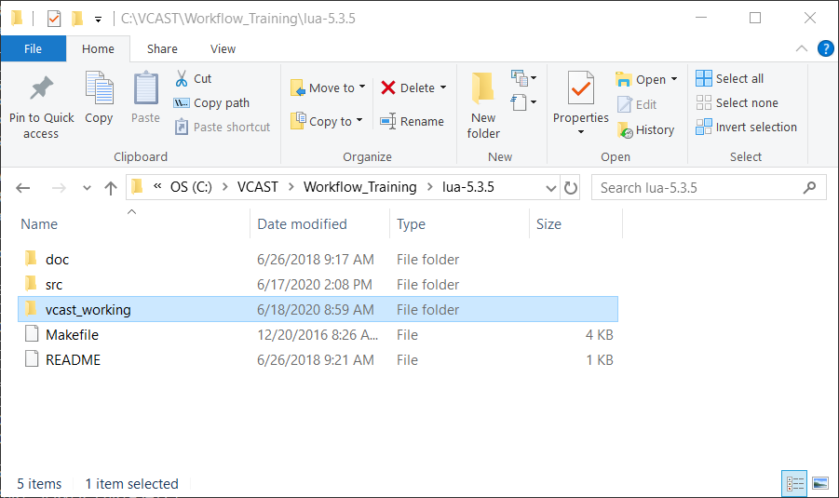
Lecture: Workflow Preparation
VectorCAST Working Folder Structure
Notes:
The VectorCAST working directory is relative to the source code.

Slide 34
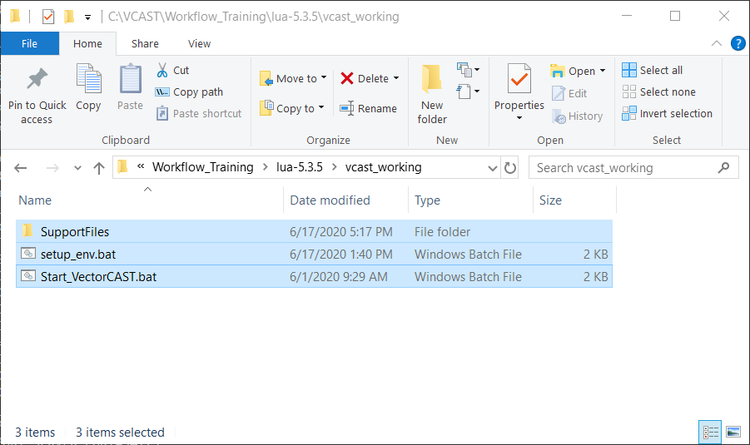
Lecture: Workflow Preparation
VectorCAST Working Folder Structure
Notes:
Inside VectorCAST working directory contains the Support Files folder and the start up scripts for VectorCAST.
Of course there will be other files once we create a VectorCAST Project.

Slide 35
Lecture: Workflow Preparation
VectorCAST Start-up Scripts
VectorCAST is started via two .bat/.sh scripts
setup_env.bat/.sh
Establishes environment variables used for automation and portability
Specifies VectorCAST installation directory and license file
Directories containing executables for build tools and VectorCAST executables
Placed on default PATH environment variable
Start_VectorCAST.bat/.sh
Calls setup_env.bat/.sh
Starts VectorCAST
Why have two scripts? Why not set up environment variables in Start_VectorCAST.bat/.sh?
Notes:
The reason there are two scripts is mainly because of Jenkins.
Jenkins will start VectorCAST automatically. Therefore the setup_env.bat/sh script will not need to start VectorCAST.

Slide 36
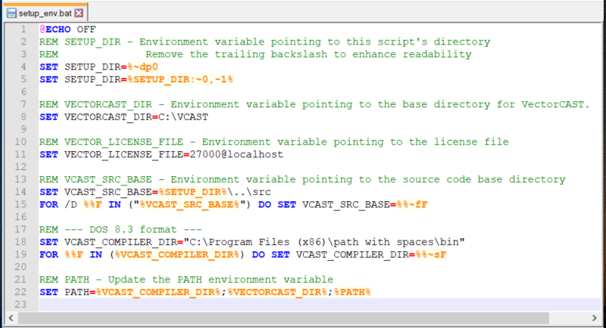
Lecture: Workflow Preparation
Windows Batch
Notes:
Line 4: %~dp0 – Expands the drive and path of argument ‘0’ (the call to itself).
Line 5: Removes the trailing ‘\’ from %~dp0. The trailing backslash is hidden in %~dp0. Removing it makes it more readable.
Line 14: Contains a relative path to the source code.
Line 15: Expands the relative path to absolute path.
Line 18: An example of a path with spaces.
Line 19: Converts folder names that have spaces to DOS 8.3 format.
This is a good time to show what would need to be done to find the short file names using “dir /x
Line 22: Put the compiler directory in front of VECTORCAST_DIR.

Slide 37
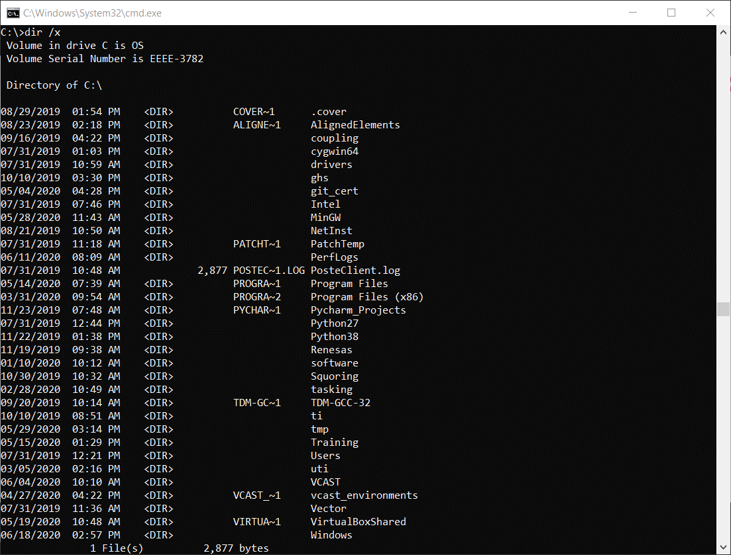
Lecture: Workflow Preparation
Manually Finding DOS 8.3 Short File Name Format
Use “dir /x” on each folder name that has spaces.
The /x switch shows a file’s short name when the long name doesn’t comply with 8.3 naming rules.

Slide 38
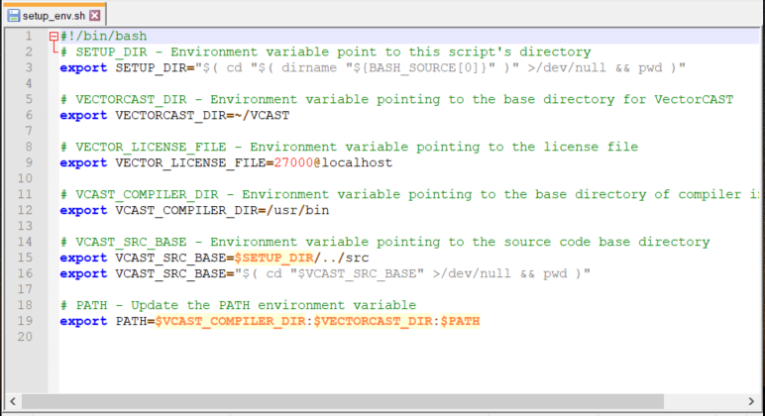
Lecture: Workflow Preparation
Linux Shell

Slide 39
Lecture: Workflow Preparation
Collecting Build Information
VectorCAST uses the same preprocess, compile and link commands that are used with your existing project.
Preprocess to expand macros
-I options
-D options
Optimizations
Two methods for collecting build information
Redirect the standard output to a file.
Some tools supply a build log
Use built-in VectorCAST “vcshell” command line utility.
Listens in the background during a normal build of your project and creates a database of the build commands, defines (-D), includes (-I), etc.
Commands to extract information from the database.
Notes:
Normal build = build without VectorCAST instrumentation.

Slide 40
Lecture: Workflow Preparation
Redirect Standard Output
Standard output can be redirected from the command line using ‘>’
make generic > build_log.txt
Redirects standard output to build_log.txt
make generic >> build_log.txt
Redirects standard output and appends to build_log.txt
make generic 1> build_log.txt 2>&1
Standard output is redirected to build_log.txt identified by output 1
Standard error output (2) is redirected and appended to build_log.txt

Slide 41
Lecture: Workflow Preparation
Creating a vcshell Database
What is vcshell?
VectorCAST command line utility
Records build commands by listening in the background during the application build process
Commands are stored in a database file
Default file name: vcshell.db
File specific build commands, file listing, etc. can be easily accessed by the command line utility “vcdb” (explained on next slide)
Example
%VECTORCAST_DIR%\vcshell --vcbg --echo --out=build_log.txt make generic
--vcbg is necessary to record commands
--echo (Optional) Output commands to a file
Default file name -> vecho.out
--out used in conjunction with --echo to change default file name
Notes:
--echo and –out are optional.
Sometimes the user may want to have a text file as well.

Slide 42
Lecture: Workflow Preparation
Using vcdb Database Utility
The “vcdb” utility is used to access commands and options recorded by vcshell.
Common database options and commands used with vcdb.
Command Verb (--cmd-verb=)
Compiler executable.
Required by some database commands.
To display all command verbs in the database use “dumpverbs” database command.
Compile Flag (--cflag=)
Compile flag used to compile application.
Output Flag (--outputflag=)
Primary output whether it is an executable, object file or preprocessed C code.
getcommand
Displays the full command of a specific file.
getppoptions
Displays preprocessor flags.
getfiles
Lists all recorded files in the database

Slide 43
Lecture: Workflow Preparation
vcdb examples
vcdb dumpverbs
Dump all verbs used during the build
vcdb –cmd-verb=gcc.exe dumpcommands
Dump all commands used durning buld.
vcdb --cmd-verb=gcc.exe --file=lapi.c getcommand
Returns the compile command for a specific file.
vcdb --cmd-verb=gcc.exe --cflag=-c --outputflag=-o getapps
Returns a list of the application output files.

Slide 44
Software Test Automation for High Quality Software
Link to Lab: Workflow Preparation

Slide 45
Lecture: Workflow Preparation
Quiz: Where should the VectorCAST working folder be located?
A
Anywhere on the hard drive.
B
Relative to the code under test
C
In “My Documents” folder
Notes:
Answer is A.

Slide 46
Lecture: Workflow Preparation
If spaces exist in a file path that VectorCAST uses, what should be done?
A
Nothing
B
Change the folder names with spaces
C
Use DOS 8.3 File Name format
Notes:
B & C
If the names cannot be changed, then DOS 8.3 must be used.

Slide 47
Software Test Automation for High Quality Software
Lecture: Unit Test Workflow

Slide 48
Lecture: Unit Test Workflow
Unit Test Workflow Overview
Template Unit Test Environment
Create a VectorCAST Project based off of template environment
Promote/demote configuration settings

Slide 49
Lecture: Unit Test Workflow
Template Unit Test Environment
Create a stand-alone unit test environment
Start off with a relatively “simple” file
Mitigate as many outside influences as possible
VectorCAST Project Manager
Runtime Support Package (RSP) development
Ensure that VectorCAST can:
Load instrumented code on the target
Receive coverage information from target
Target can be a simulator
Support files
Directory containing supplementary files
Custom linker files
Intrinsics
Start-up scripts
Create a VectorCAST Project based off of template environment
Import compiler and RSP settings using the template environment’s CCAST_.CFG
Notes:
Essentially what you are doing with a template environment is getting instrumentation of source and communication with the target working first. Once that is complete we can use the CCAST_.CFG file to build the VectorCAST Project.

Slide 50
Lecture: Unit Test Workflow
Runtime Support Package
Provides an interface layer of communication when testing on an embedded target.
Test case execution can be done on an embedded target environment.
Test software that cannot be tested on host due to target dependencies.
Target can be:
Host machine
Simulator – vVIRTUALtarget, TRACE32, uVision, etc.
Remote target platform
Architecture of target is not important.
VectorCAST only needs a mechanism to send and retrieve ASCII test data to and from the test harness.

Slide 51
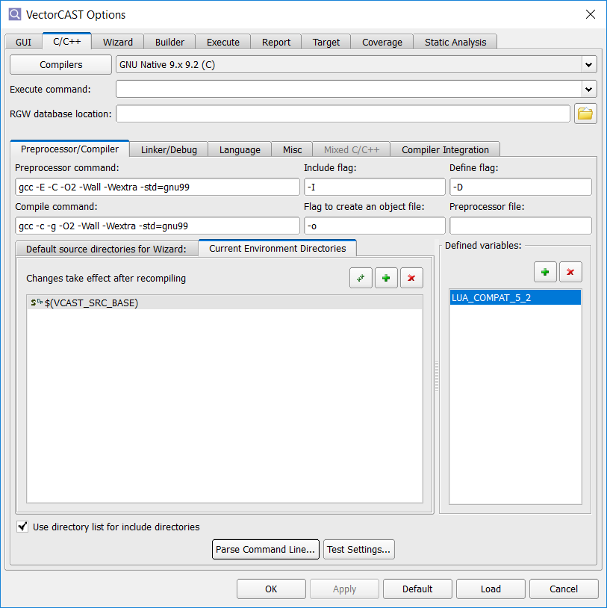
Lecture: Unit Test Workflow
Execute Command
Controls how VectorCAST interfaces with specific compiler and target.
VectorCAST automatically fills out this command based on the compiler template chosen.
Scripts in VCAST/DATA
Windows and Linux scripts
Two types of entries:
Actual command sequence used to execute the cross-compiled program
GHS: simarm
“Flag” command that tells VectorCAST to use a series of built-in command sequences to execute the target program.
IAR ARM9 ver 5: <<iar_5x_tgt>>
Notes:
There are two types of entries that can be put into this field. One is the actual command sequence that
should be used to execute the cross-compiled program; the other is a “flag” command that tells
VectorCAST to use one of a series of built-in command sequences to execute the target program.
The command sequence method is used for Instruction Set Simulators (ISS) which have a shell, or
command line interface, that can be used to run target programs. For instance the Green Hills PPC
compiler has an ISS for the PowerPC called simppc. The default “Execute Command” field for this
compiler is simppc -ppc603 because the way you can run target programs under the simulator is to
issue the shell command simppc -ppc603 my_program.exe.
The flag technique is used for more complex mechanisms that require VectorCAST customization.
See C/C++ RSP users guide for a full list of execute and flag commands.

Slide 52
Lecture: Unit Test Workflow
Parse Command Line and Test Settings Utilities
Retrieve build flags and settings from vcshell database or build log.
Parse Command Line
Automatically extract include paths (-I) and defined variables (-D).
Convenient for complex compiler options
Test Settings
Used to determine if theses compiler settings will work when building an environment.
Reasons why compiler settings won’t work
Missing defined variables
Source directories not in correct order
Missing library include directories
Enter Preprocessor, compile and linker commands in the appropriate fields
Notes:
It’s a good idea to mention here that if the customer has a mixture of C and C++ files there is a separate tab for the C compiler options and flags.

Slide 53
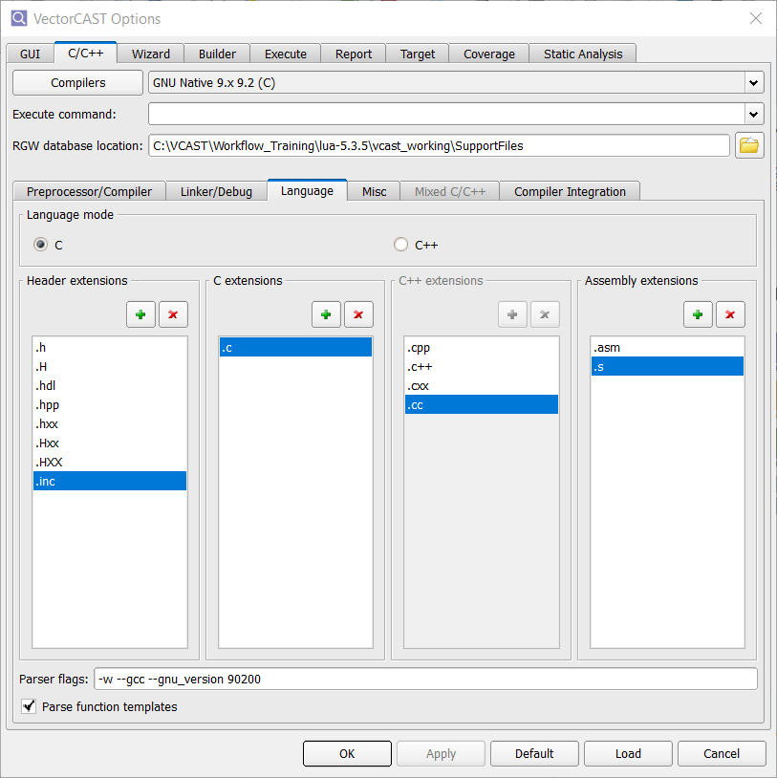
Lecture: Unit Test Workflow
Parser Flags
VectorCAST uses 3rd party parser (EDG)
Flags are acquired from VectorCAST support
Common flags
--define_macro=
--64_bit_target
Mixture of C and C++
C parser flags are entered on Mixed C/C++ tab
C++ entered on Language tab
Notes:
“--define_macro=“ is used to define or redefine a macro.
“--64_bit_target” This sets the configuration for a 64 bit machine. It is needed to set the correct size of the size_t type.
If there is a mixture of C and C++ files, the C parser flags are entered on Mixed C/C++ tab and the C++ parser flags are entered on the C/C++ tab

Slide 54
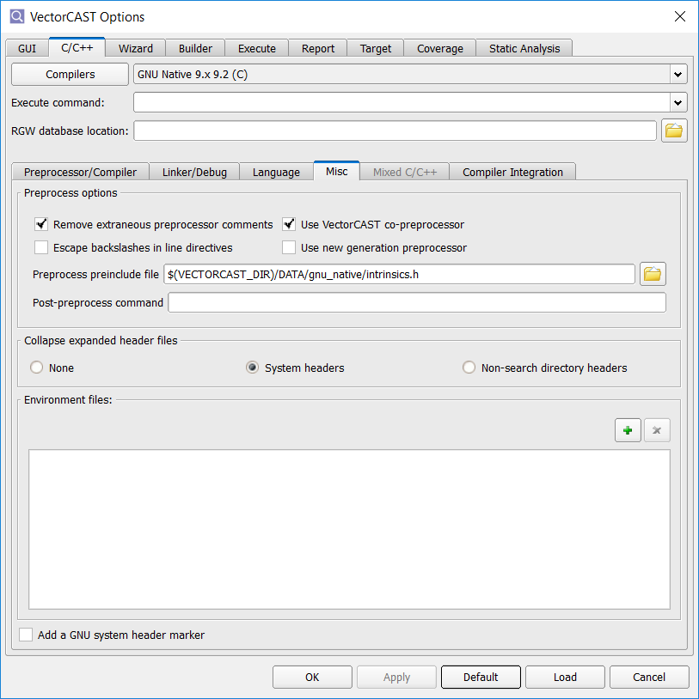
Lecture: Unit Test Workflow
Misc. Tab
What does the preprocessor do?
Processes commands that begin with ‘#’ known as directives
Expands macros and included files
Replaces symbolic constants with actual values
Removes comments unless –C option is used.
Post-preprocess command allows you to specify a custom script that transforms non-standard code constructs into code suitable for the parser.
VectorCAST passes 3 arguments
Original file path
Preprocessor output file path
Path to an output file that does not yet exist
Environment files are files that need to be copied into the environment directory during environment build or rebuild
Post-preprocess, start-up scripts, etc.
Notes:
Four stages of compilation
Preprocessing
Compiling
Assembly
Linking

Slide 55
Lecture: Unit Test Workflow
Misc. Tab cont.
Collapse expanded header files
#include’s are expanded so that the compiler can find the header files
System header files are the interface between application code and system calls and libraries
User created header files are the interface between the source files for the application
During preprocessing the paths to header files and macros are expanded.
Header files are copied into build directory
#include’s are collapsed to original statement
To save preprocessed output use --save-temps
This option is set by the chosen template.
Notes:
During environment build, whenever VectorCAST modifies a unit for stub-by-function, Visual Studio whitebox, or code coverage, it may first preprocess the unit to expand macros and header files. This option tells VectorCAST which expanded header files should be re-collapsed before compiling the test harness. When a header file is re-collapsed, it is replaced with the original #include statement.
--save-temps will save
*.i, *.ii – C or C++ file after preprocessing
*.s – Assembly file
*.o – Output object file

Slide 56
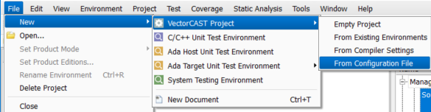
Lecture: Unit Test Workflow
Create VectorCAST Project
Save the configuration file from the template environment in the Support Files folder.
Used as a backup
The configuration file that was generated for the template environment is used to create a VectorCAST Project.
Compiler node created with all configuration settings
Notes:
Now that we have a working template env save the configuration file in the SupportFiles folder. This can be used as backup in case something happens and you need to recover settings.
Once the template environment has been created the configuration file is used to create a VC project.

Slide 57
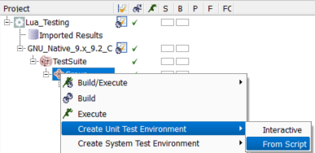
Lecture: Unit Test Workflow
Import Template Environment
Import the template environment by using the *.env script
Settings from the compiler node are automatically inherited
Right click on the Group node and create the unit test environment from script
Notes:
Next we want to import the template environment into the VectorCAST project. The *.env script is contains all relevant information for the environment. Since the compiler node is already configured the template environment will automatically inherit the settings from the parent compiler node.
Right click on the group node and select Create Unit Test Environment->From Script
VectorCAST will automatically build the environment and open it.

Slide 58
Lecture: Unit Test Workflow
Promote and Demote Options
Options and settings can easily be promoted/demoted to another configurable node
Configure options that are common to a particular node
Open the configuration editor for a node
Right click in the editor window and select Column Options
The column options will be displayed at the bottom of the configuration editor
Each column is a configurable node
Each node’s settings can be compared and promoted/demoted
Cells highlighted in yellow denote settings inheritance
Grey cells are not configured
Notes:
Promoting/demoting options can be done by opening a configuration from the project view. Once it is open right click anywhere in the configuration settings and select Column Options. The options can then be compared and promoted/demoted between configurable nodes by copying and pasting.

Slide 59
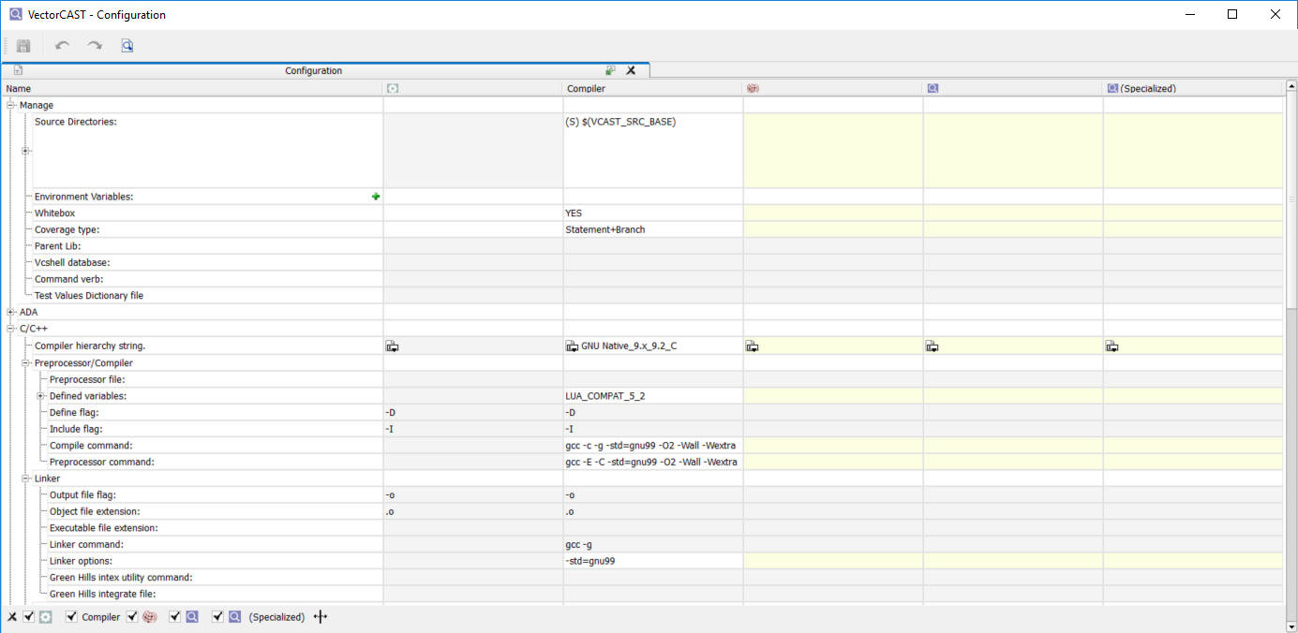
Lecture: Unit Test Workflow
Column Options

Slide 60
Software Test Automation for High Quality Software
Link to Lab: Unit Test Workflow

Slide 61
Software Test Automation for High Quality Software
Lecture: System Test Workflow

Slide 62
Lecture: System Test Workflow
System Test Workflow Overview
Where does VectorCAST/QA fit?
What is VectorCAST/QA?
Terminology
How the pieces fit together?
Steps to setup VectorCAST/QA

Slide 63
Lecture: System Test Workflow
What is VectorCAST QA
VectorCAST QA is a system testing tool.
Unit testing
Instrument one file or a subset of files
Stub external dependencies
Set input and expected values
System testing
Entire application is instrumented
No stubbing
Exercise the application with scripts or manual testing procedures
Notes:
Up to this point we have been isolating one unit and controlling what is input into the unit and collecting results. With VectorCAST QA, the entire application is instrumented and executed on host, target or simulator.

Slide 64
Lecture: System Test Workflow
Where VectorCAST QA Fits into Your Development Process
Requirements Specification
System
Testing
Architecture
Integration Testing
VectorCAST QA
System
Design
Unit
Testing
Coding
Notes:
The product portfolio has features and options that help you throughout your development process.
Continuous integration helps to make sure your product maintains high quality throughout development.
On the left side of the V, VectorCAST integrates with other tools you have in your development environment.
VectorCAST products reside on the bottom and right side of the V where testing takes place.
VectorCAST encourages a Correct, Complete Continuous approach to software testing.
Correct: Code correctness is the basis for high integrity (safety critical) software
Complete: Vector offers tools to support ALL your testing – not just your software testing. And it supports thoroughness of your testing.
Continuous: Testing should be done early and often and VectorCAST supports that through automation, dashboards, and integrations with tools like Jenkins.

Slide 65
Lecture: System Test Workflow
Terminology
System Testing | Testing methodology that’s applied to a Software Project (Drivers, Interfaces, Application, etc.). Tools to develop system tests are CANoe, vTestStudio, NI Test Stand, Python Scripts, debuggers, etc.
Preprocessor | Compiler mechanism to breakdown macros, header files, and tag for compilation
Translation Unit Parser | Output of the preprocessor (*.tu.c, *.tu.cpp) Commercial tool to parse through the TU
Instrumentation | Code added to your source code by VectorCAST to keep track of what statements and branches have been executed
System Testing Environment | VectorCAST environment that lists the source files to instrument for code coverage. Formally VectorCAST/Cover
VectorCAST/QA | VectorCAST platform that consists of a System Testing Environment and the automation of System Test Verification with code coverage
Notes:
Just go through these, the definitions build on each other.

Slide 66
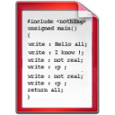

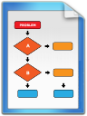
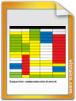
Lecture: System Test Workflow
How the pieces fit together
VectorCAST/QA
VectorCAST
Source
Instrumented Source
Instrumented binary application
Preprocess
Parse
Instrument
Compile
System Testing Environment
Automate
Load/Flash
Collect Coverage
Target
System Test
Reports
Coverage Data
Coverage data via UART, File, CAN, debugger, etc. and log to file on host

Slide 67
Lecture: System Test Workflow
Steps to setup VectorCAST/QA
Collect a build log of the source code application
Create a VectorCAST System Testing Environment and choose a template that matches the source code’s compiler
Use the build log to adjust VectorCAST Options
Select the source code to add for code coverage
Instrument the source code
Adjust the target’s I/O mechanism for VectorCAST’s coverage output API (c_cover_io.c/c_cover_io.cpp)
Compile the instrumented source code along with c_cover_io (*)
Flash the instrumented binary onto the target or simulator (*)
Execute the system test using system testing procedures (CANoe, vTestStudio, scripts, etc.) (*)
Collect coverage by calling VectorCAST’s coverage output API and log the contents to a .DAT file (*)
Import the .DAT file into VectorCAST System Testing Environment
Create regression scripts
Save regression scripts and other support files into configuration management
(*): Points of automation based on third-party capabilities
Notes:
This slide is describes the steps for creating a QA environment. We already have the build log and build options are configured from the unit test environment.

Slide 68
Lecture: System Test Workflow
Build Log and VectorCAST QA Preparation
Build log already created during workflow preparation.
vcshell database
Text file
Build log is used to set options in VectorCAST QA environment and to choose compiler template.
Once compiler template is determined create test suite and group for system testing
Separate from unit test environments
May be options unique to system testing

Slide 69
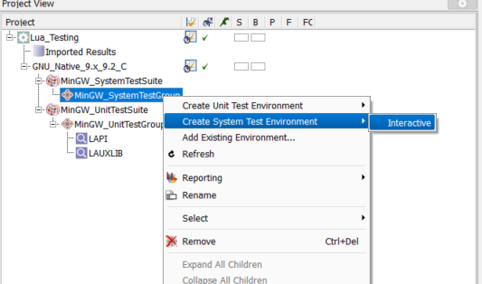
Lecture: System Test Workflow
VectorCAST/QA Environment Creation
Create system test environment
Right click on system test group node and select Create System Test Environment->Interactive
Follow 5 step process to build environment.
Notes:
Right click on system test group node and follow the interactive steps.

Slide 70
Lecture: System Test Workflow
I/O Mechanism
Step 4 Coverage Options of QA Environment Creation Wizard
Real Time
VectorCAST gathers coverage data as test is executing and writes results immediately to file.
Can significantly slow down test execution
Buffered
Store coverage data in a buffer
Periodically call VCAST_DUMP_COVERAGE_DATA()
Can be called from a Probe Point so that source does not need to be edited.
Animation
Play back coverage results in coverage viewer (unit test only)
Notes:
When system testing on target buffered mode is recommended to speed up execution.

Slide 71
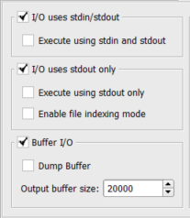
Lecture: System Test Workflow
Other I/O Options
Accessed via Tools->Options->Target->Input/Output Options
I/O uses stdin/stdout
Target does not have file I/O capability
VectorCAST reads input data via stdin and writes output through stdout
I/O uses stdout only
Target only has stdout capability
Data is compiled into the test harness
Buffer I/O
Target does not have stdin capability and cannot write to files. The data is buffered within memory. This is usually used when the target doesn't have stdin or stdout capability

Slide 72
Lecture: System Test Workflow
Regression Scripts
Regression scripts allow the regeneration of the tool options and the test environment.
Files created:
Batch file environment_name.bat/sh
Environment script environment_name.enc with instructions on how to build environment
Contains source file information and probe points
XML format
Called by environment_name.bat/sh
If environment has imported results environment_name.cvr is created

Slide 73
Lecture: System Test Workflow
Coverage Output API
Cover I/O Type set to “Buffered”
Coverage data written to buffer on target
Buffer needs to be periodically dumped before it fills up
VectorCAST provides API function VCAST_DUMP_COVERAGE_DATA()
Writes out coverage data from buffer to a file
Default file name is TESTINSS.DAT
Can be called in a probe point
Source does not need to be edited.
Call from periodic routine.
Notes:
Calling VCAST_DUMP_COVERAGE_DATA() from a probe point eliminates the need to edit the source code.
#IFDEF VECTORCAST
VCAST_DUMP_COVERAGE_DATA() ;
#ENDIF

Slide 74
Lecture: System Test Workflow
Coverage IO Files
VectorCAST Cover I/O files
The I/O files are in the environment directory and are called:
c_cover_io.c for C source files
c_cover_io.cpp for C++ source files
vcast_c_options.h, c_cover.h included by the above
vcast_cover_io.adb, for Ada source files
vcast_cover_io.ads
I/O files contain the Data Structures & Functions needed to record the Coverage Information
When compiling/linking the instrumented source files, you must include the appropriate I/O file (for “c”, e.g., link in c_cover_io.c)
Add to your compile command: gcc -g -c manager_driver.c manager.c database.c %COVER_ENV%/c_cover_io.c
Append through the GUI
IMPORTANT: Note that you may need to customize the I/O files to support the particular I/O mode and I/O API that exists on your target.

Slide 75
Lecture: System Test Workflow
Building an Instrumented Executable
Two Methods
Use the System Test Script in VectorCAST
Right mouse on Environment -> System Testing->Edit Script
Add Build Command to Python Script
Optionally, add Execution Scripts
Use Normal Build Mechanism to build your application
e.g.,, makefile, Visual Studio Project, Eclipse Project. etc…
Add c_cover_io.c to your project
Add the include path for vcast_c_options.h & c_cover.h
Note that vcast_c_options.h changes if instrumentation options change.

Slide 76
Lecture: System Test Workflow
Applying Coverage to the Source Tree
The Apply Coverage to Source Tree option specifies where instrumented files are stored and how they are used by VectorCAST.
When a QA environment is created a separate instrumentation directory is created to store the instrumented source code.
vcast_working\vcast_qa\Lua_System_Test\vc-inst
Option can be accessed by right clicking on QA environment an selecting System Testing->Apply Coverage to Source Tree
Three options
During Build (default)
Source code copied to backup files and replace with instrumented code.
Build is performed via system_tests.py script
When build is complete original source files are restored and instrumented files are moved back to vc-inst directory.
Always
Source code backed up and replaced with instrumented code.
Only way to revert code is to un-instrument the application
Never
Instrumented code is stored in vc-inst
Build is performed with un-instrumented files
Notes:
During build option prevents unwanted instrumented source code check in to config management.
Always option to get original code back in source directory is to un-instrument the application
Reason for using During Build
Minimum impact on SCM systems
If project deleted instrumented files are not left behind
Source code can be changed without first un-instrumenting
Reason for using Always
Debugging instrumented executable
Building from an IDE outside of VectorCAST
Reason for using Never
Comparing test results with instrumented and un-instrumented code

Slide 77
Software Test Automation for High Quality Software
Lecture: Configuration Management

Slide 78
Lecture: Configuration Management
Configuration Management Overview
VectorCAST Project artifacts that need to be saved

Slide 79
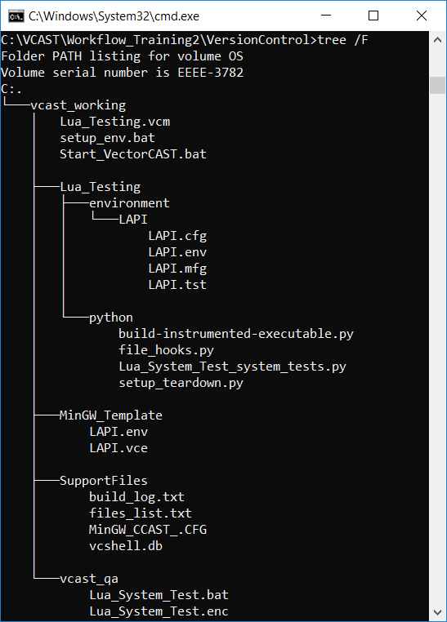
Lecture: System Test Workflow
Folder Structure
The goal here is to save a minimal set of VectorCAST Project files and still be able to regenerate the VectorCAST Project on any machine.
We maintain the folder structure and eliminate any files that are not necessary to regenerate the VectorCAST Project
The screen shot shows the correct listing of files
Folders of interest:
vcast_working
Lua_Testing
Environment
Python
MinGW_Template
SupportFiles
vcast_qa
Notes:
The main point of this slide is to convey that all of VectorCAST artifacts do not need to be saved.
If we were to save everything the SCM server would fill up rather quickly.

Slide 80
Lecture: System Test Workflow
vcast_working
The vcast_working folder stores all VectorCAST artifacts. But we don’t need to save everything.
We will keep all folders for now but eliminate extraneous files from this working directory.
Files to check-in:
Lua_Testing.vcm
This is the main project file.
setup_env.bat
Start_VectorCAST.bat

Slide 81
Lecture: System Test Workflow
vcast_working\Lua_Testing
The Lua_Testing folder contains environment specific folders and files.
Folders of interest:
environment
Contains all unit test environment artifacts
Everything in this folder is checked-in to SCM
python
Remove all *.pyc files. These are compiled Python scripts and are regenerated when a Python script is executed.
All other files and folders can be removed.

Slide 82
Lecture: System Test Workflow
vcast_working\MinGW_Template
The MinGW_Template folder contains all artifacts related to our template unit test environment.
Files of interest:
LAPI.env
CCAST_.CFG
The build folder and all other files can be removed.

Slide 83
Lecture: System Test Workflow
vcast_working\SupportFiles
The SupportFiles folder contains custom scripts, header files, etc.
In our labs we also stored build logs, file list, a working CCAST.CFG and vcshell database. Although these files are not necessary to rebuild the VectorCAST Project, they can be stored in SCM as a baseline.
Save all files in this folder.

Slide 84
Lecture: System Test Workflow
vcast_working\vcast_qa
The vcast_qa folder contains all artifacts related to our VectorCAST\QA environment.
However, all files are not necessary to regenerate the QA environment. All that is necessary is the regression scripts.
Files of interest:
Lua_System_Test.bat
Lua_System_Test.enc
To regenerate the entire QA environment execute the batch file.

Slide 85
Software Test Automation for High Quality Software
Lecture: Continuous Integration

Slide 86
Lecture: Continuous Integration
What is Continuous Integration?
Continuous integration is a strategy for software developers to help increase the speed of development by building and testing an application frequently.
Developers commit code changes daily
Continuous integration software automatically builds and runs tests.
Goal is to find bugs early.
Less man hours to debug, identify and fix.
Popular Continuous Integration Tools
Jenkins
Bamboo
GitLab
Notes:
Continuous integration (CI) is a software development strategy that increases the speed of development while ensuring the quality of the code that teams deploy.
Best thing about the most popular CI tools is that they are FREE!!!

Slide 87
Lecture: Continuous Integration
Jenkins Integration with VectorCAST
VectorCAST plug-ins are available for Jenkins CI tool
Checks out application code and VectorCAST Project from SCM
Sets up environment for testing
Executes tests and reports results
Takes advantage of VectorCAST’s Change Based Testing
Two types of supported Jenkins jobs
Single job
Creates a single job to build and execute environments in VectorCAST Project.
Executed on one target computer
Pipeline job
Builds and executes all environments in a VectorCAST Project in parallel.
Speeds up test execution
Notes:
Multi job has been deprecated

Slide 88
Lecture: Continuous Integration
Jenkins Integration with VectorCAST
Prerequisites for Jenkins Integration
VectorCAST must be installed on each Jenkins node performing the job.
Access to license server
Pipeline can consume more than one license
Application build tools must be installed on Jenkins node performing the job
Running tests on target
Flash programming tools must be installed
All necessary connections to target
Credentials for SCM and other tools

Slide 89
Lecture: Continuous Integration
Jenkins Integration with VectorCAST
Creating a Single Job
Path to the VectorCAST Project
Relative to the SCM check-out root
Script commands
Call to setup_env.bat/sh
Optionally use reporting
SCM Integration
Repository URL
Credentials to access repository

Slide 90
Software Test Automation for High Quality Software
VectorCAST Workflow Training Lab Work

Slide 91
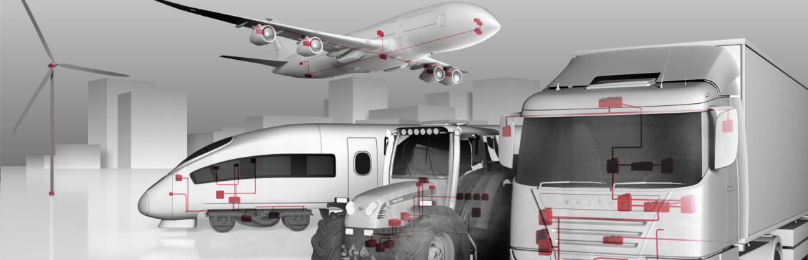
Software Test Automation for High Quality Software
Lab: Workflow Preparation

Slide 92
Lab: Workflow Preparation
Edit setup_env.bat
Navigate to C:\VCAST\Workflow_Training\lua-5.3.5\vcast_working
Open setup_env.bat in your favorite text editor.
Locate “SET VECTORCAST_DIR=“
Insert the file path to your VectorCAST installation directory.
Locate “SET VECTOR_LICENSE_FILE=”
Insert the file path to your VectorCAST License file.
Locate “SET VCAST_SRC_BASE=%SETUP_DIR%\..\src” and update with a relative path to the source code base directory.
You should not have to change this.
Locate “SET MINGW_BASE_DIR=“
Enter the file path to the base directory of MinGW.
Locate “SET MINGW_COMPILER_DIR=“.
Use the environment variable “MINGW_BASE_DIR” to set the file path to the “gcc” binaries.
Locate “SET MINGW_MAKE_DIR=“.
Again use the environment variable “MINGW_BASE_DIR” to set the file path to the “make” binaries.
Add “MINGW_COMPILER_DIR” and “MINGW_MAKE_DIR” to the front of the default “PATH” environment variable.
Make sure that you add these variables before %VECTORCAST_DIR%”.
SET PATH=%MINGW_COMPILER_DIR%;%MINGW_MAKE_DIR%;%VECTORCAST_DIR%;%PATH%

Slide 93
Lab: Workflow Preparation
Edit setup_env.bat Continued
Locate “ARM_COMPILER_DIR” and enter the location the ARM EABI binaries. Usually in the “bin” directory.
Locate “TRACE32_SIMULATOR_DIR” and enter the directory to the TRACE 32 installation.
Add “TRACE32_SIMULATOR_DIR”, “ARM_COMPILER_DIR”, “MINGW_COMPILER_DIR” and “MINGW_MAKE_DIR” to the front of the default “PATH” environment variable.
Make sure that you add these variables before %VECTORCAST_DIR%”.
*** See screen shot on the next page. ***

Slide 94
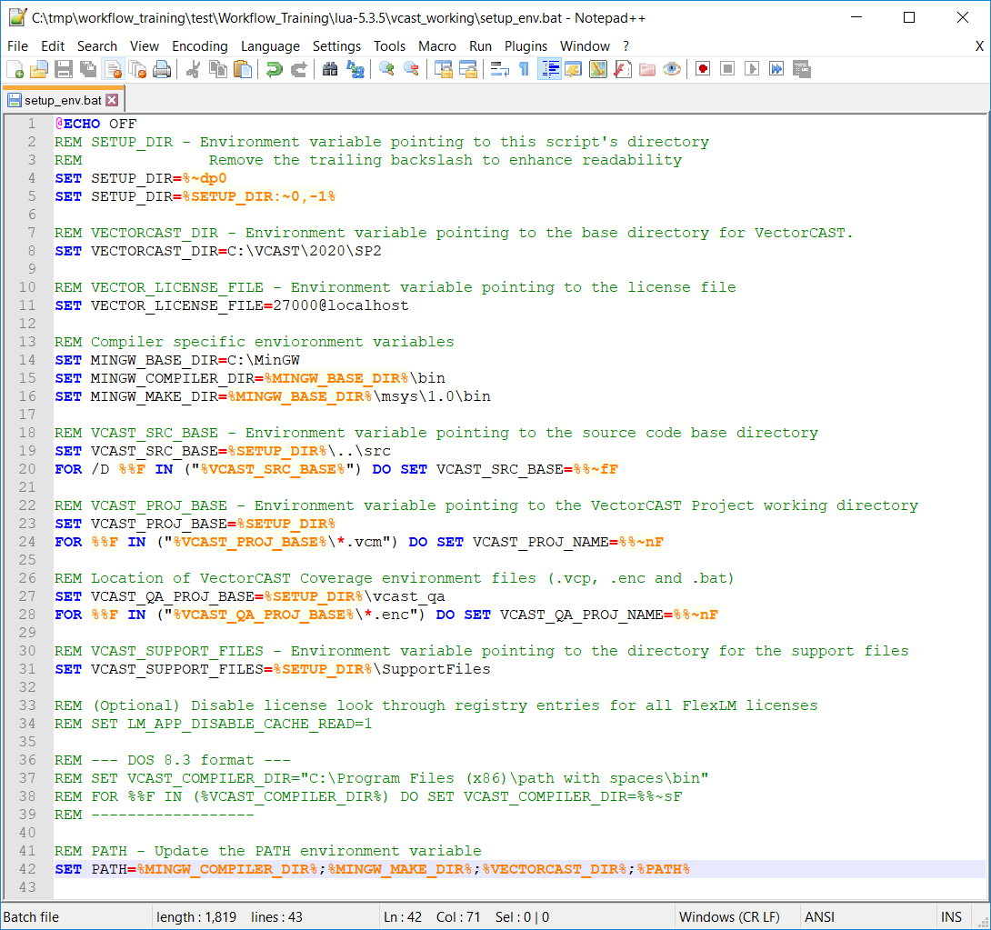
Lab: Workflow Preparation
Edit setup_env.bat
Your setup_env.bat file should look something like this.
Note the default PATH environment variable.

Slide 95
Lab: Workflow Preparation
Test Environment Variables
Next, we are going to check that the environment variables were set correctly.
Navigate to the “vcast_working” directory and execute Start_VectorCAST.bat.
After VectorCAST opens click on Help->Available Licenses.
Look for VECTOR_LICENSE_FILE. The correct file path should be displayed in the window.
Select Tools->Custom Tools->Command Prompt
Alternatively select the Command Prompt button on the tool bar.
Change directories using the environment variables to test that the file paths are correct.
Enter “cd %MINGW_BASE_DIR%”.
The command prompt should change to the correct directory.
Do the same for MINGW_COMPILER_DIR, MINGW_MAKE_DIR and VECTORCAST_DIR.
Ensure that the default PATH environment variable was set correctly.
Enter “set” at the command prompt (see next page for screen shot).
Examine the default “PATH” variable and confirm that the paths to the MinGW compiler and “make” directories exist at the beginning.
Enter “gcc –v” to display the version of gcc that is installed in the MinGW installation dir.
Make a note of what version of gcc is being used. We will need the version number in other labs.

Slide 96
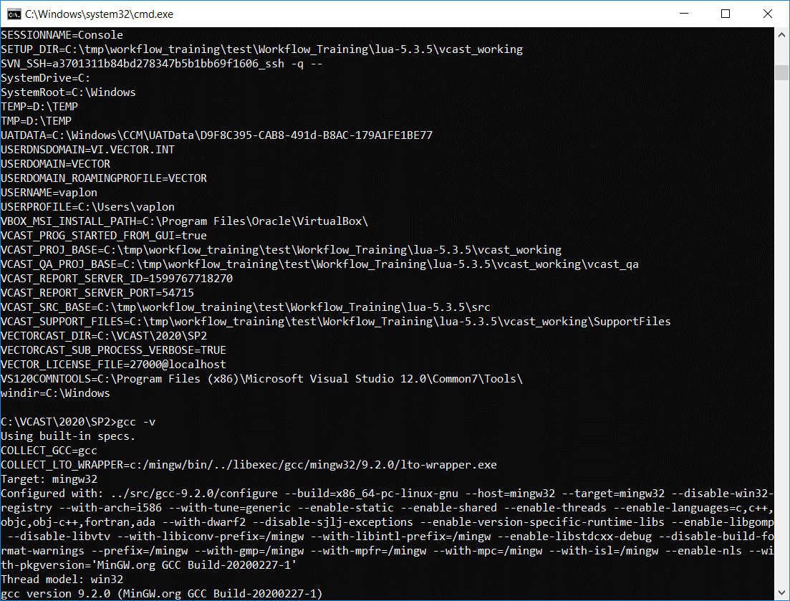
Lab: Workflow Preparation
Screenshot of Environment Variables

Slide 97
Lab: Workflow Preparation
Create a vcshell Database and Build Log for MinGW
In the command prompt window navigate to the “SupportFiles” directory.
Enter “cd %VCAST_SUPPORT_FILES%”
Running the vcshell command from SupportFiles will place the vcshell database in this directory.
Enter “vcshell --vcbg --echo --out=build_log.txt make -C %VCAST_SRC_BASE% clean generic”
Navigate to the “SupportFiles” directory.
It should now contain two files vcshell.db and build_log.txt.
Practice using commands to extract information from the database with the “vcdb” utility tool.
To see a list of compile command verbs used during the build enter the following:
vcdb dumpverbs
You should see “gcc.exe” in the list. We will need this information in other commands.
To get a list of files that have been compiled enter the following:
vcdb --cmd-verb=gcc.exe getfiles >> files_list.txt
The “SupportFiles” directory should now contain a file named “files_list.txt”.
To retrieve a compile command for a particular file enter the following:
vcdb --cmd-verb=gcc.exe --file=lapi.c getcommand
To retrieve linker commands enter the following:
vcdb --cmd-verb=gcc.exe getlinkcmd

Slide 98
Software Test Automation for High Quality Software
Lab: Creating Tests

Slide 99
Lab: Unit Test Workflow
MinGW Template Environment
Open a command prompt from VectorCAST and create a directory in “vcast_working” named “MinGW_Template”
mkdir MinGW_Template
In VectorCAST change the working directory to the MinGW_Template directory.
File->Set Working Directory
Preprocess, Compiler and Linker Commands
File->New->C/C++ Unit Test Environment to open the Environment Creation wizard.
Click on the Compilers button and select GNU Native->9.2->C (If using a different version of MinGW select the appropriate version).
From the command prompt navigate to the SupportFiles folder and get the compile and linker command for source file lapi.c from the vcshell database. Note: Paste these commands into a text document for use in later steps.
vcdb --cmd-verb=gcc.exe --file=lapi.c getcommand
vcdb --cmd-verb=gcc.exe getlinkcmd
Copy the compile command for lapi.c from the command prompt.
Highlight the command, right click on the title bar and select Edit->Copy
In the Environment Creation wizard click on Parse Command Line and paste the command for lapi.c and click on the Parse button.
You should see “LUA_COMPAT_5_2” in the “Defines” list. The “Includes” list should be empty.
Extract the compiler flags from the lapi.c compile command and enter them in the Preprocessor and Compiler command.
Flags: -std=gnu99 -O2 -Wall –Wextra
Extract the linker commands from the link command and enter them on the Linker/Debug tab under Linker options
Linker Command: -std=gnu99
Linker Options: -lm
Click “Next"

Slide 100
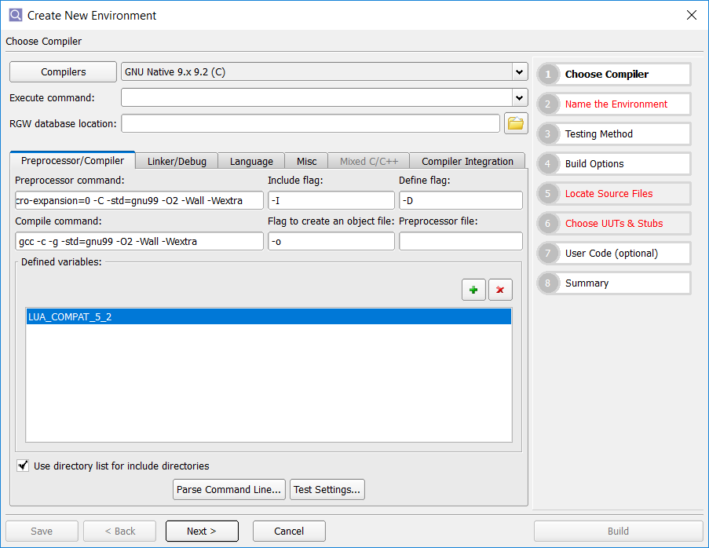
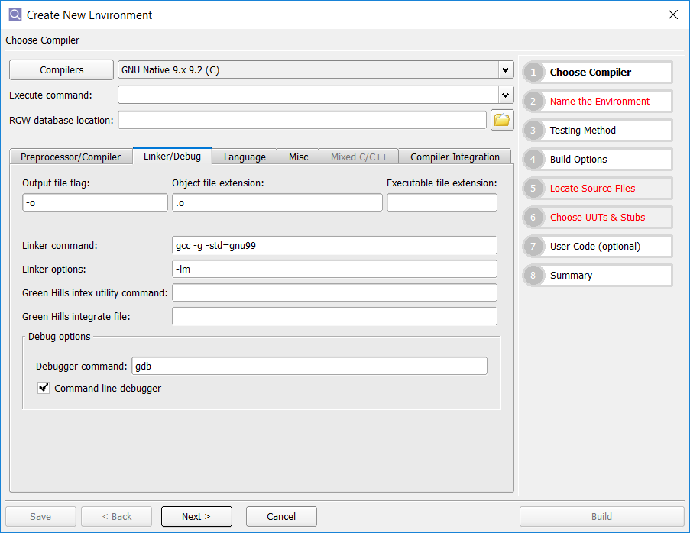
Lab: Unit Test Workflow
MinGW Template Environment con’t

Slide 101
Lab: Unit Test Workflow
MinGW Template Environment con’t
Name the environment LAPI and click Next
In step 4 Build Options select Statement+Branch for Coverage type and select Whitebox
Step 5: Locate Source Files
Click on the single green ‘+” and navigate to the “src” directory and select Choose.
Double click the absolute path to put into edit mode. Then right click on the path and select “Convert selection to environment variable”->$(VCAST_SRC_BASE)\
Step 6: Choose UUT’s & Stubs
Double click on lapi.c from the list of unit names to insert in the Units Under Test list and select Build.
Add a test case to one of the subprograms to ensure that it will run.
You may need to initialize some pointers for a test case to run without a segmentation fault.
Now that we have a working environment, save the CCAST_.CFG file to the SupportFiles folder.
Open the command prompt and navigate to the MinGW_Template directory enter the following command
copy CCAST_.CFG ..\SupportFiles\MinGW_CCAST_.CFG
Close the LAPI environment by selecting File->Close Environment.

Slide 102
Lab: Unit Test Workflow
Create VectorCAST Project Based on MinGW Template
Change the working directory to “vcast_working”.
File->Set Working Directory
Check the lower right-hand corner of VectorCAST GUI and ensure the correct directory is displayed
Create a new VectorCAST Project based on the MinGW template environment’s configuration file.
Select File->New->VectorCAST Project->From Configuration file.
Project Name: Lua_Testing
Select the configuration file by clicking on the browse button, navigate to the MinGW_Template directory, select CCAST_.CFG and click on Open.
In the Project View there should be a Lua_Testing project with GNU_Native_9.x_9.2_C compiler node.
Rename the Test Suite and Group node to “MinGW_UnitTestSuite” and MinGW_UnitTestGroup respectively
Import the LAPI environment into the project
Right click on the group node and select Create Unit Test Environment->From Script.
Navigate to the MinGW_Template directory and select LAPI.env
The environment will build and open
Insert some test cases to make sure they run to completion

Slide 103
Lab: Unit Test Workflow
Promote Common Options
Next we need to promote common options that will be used by all nodes.
Close the LAPI environment
In the Project View right click on the configuration column next to LAPI and select Open Configuration.
Right click anywhere in the configuration editor and select column options.
The column options will be displayed at the bottom of the configuration editor.
Check all boxes in the options.
We don’t necessarily need all of the columns. We are displaying all columns to demonstrate all of the configurable nodes and inherited settings.
Expand Manage and promote Source Directories to the VectorCAST Project level (gear icon)
In the project column add the directory to the source files and convert the path to VCAST_SRC_BASE environment variable.
Close the configuration editor and save.
See screenshot on next page.

Slide 104
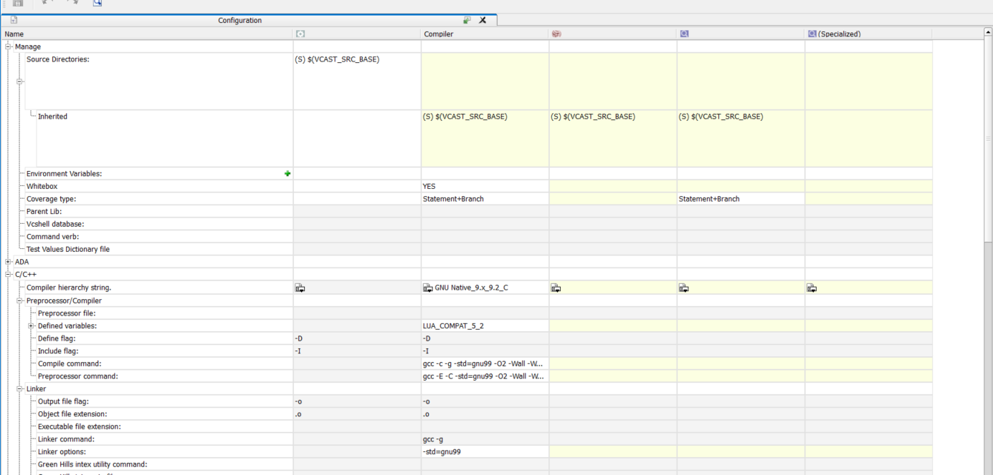
Lab: Unit Test Workflow
Configuration Editor

Slide 105
Software Test Automation for High Quality Software
Lab: Test Case Fundamentals

Slide 106
Lab: System Test Workflow
Building and Running Lua
We want to first get familiar with how Lua scripting language works. But first we need to build the application.
Close any open environments in VectorCAST.
From VectorCAST open a command prompt and change directories to lua-5.3.5
Build the executable by entering the following command
make clean generic
Change to the “src” directory and verify that lua.exe exists
Check timestamp to make sure it is current
Execute a Lua command and script
From the “src” directory execute lua.exe and enter the following commands
print “Hello world!!”
os.exit()
Change to the lua-5.3.4-tests to run sample test script
..\lua-5.3.5\src\lua.exe strings.lua

Slide 107
Lab: System Test Workflow
Create VectorCAST Environment
Now that we are familiar with Lua execution and the folder structure we can build the QA environment.
Create test suite and group nodes for system testing.
In the VectorCAST Project View right click on compiler node GNU_Native_9.x_9.2_C and select Add Test Suite
Name the new test suite “MinGW_SystemTestSuite” and click Add
Right click on MinGW_SystemTestSuite and select Add Group
Name the new group “MinGW_SystemTestGroup” and select Add
Create the QA environment
Right click on MinGW_SystemTestGroup and select Create System Test Environment->interactive
Step 2:
Name the environment “Lua_System_Test” click Next

Slide 108
Lab: System Test Workflow
Create VectorCAST/QA Environment
Create the QA environment continued.
Step 3:
From the Base Directory drop down list select environment variable VCAST_SRC_BASE
Check the box next to the “src” folder in the Source Directories pane. This will select all files for instrumentation.
Click Next
Step 4:
Use default options.
Click Build
The Environment View should now be open listing 35 files that were selected in Step 3. We are now ready to instrument the files, append c_cover_io and edit system_tests.py script

Slide 109
Lab: System Test Workflow
Instrument Source Code and Append c_cover_io.c
Instrument files for Statement and Branch coverage.
From the environment view select all files
Click in the environment view window and press Ctrl-A on the keyboard
Right click and select Instrument->Statement+Branch
This will create instrumented copies of the source code and store them in the following directory
\vcast_working\vcast_qa\Lua_System_Test\vc-inst
Lua builds two executables: lua.exe and luac.exe. Therefore, there are two main functions in each source file lua.c and luac.c. We will append Cover IO to each file.
Right click on lua.c and select Append Cover IO
Do the same for luac.c
Close environment File->Close Environment

Slide 110
Lab: System Test Workflow
Edit system_tests.py Script to Build Instrumented Application
Next we need to edit the python script to perform the instrumented build.
Right click on the Lua_System_Test environment and select
System Testing->Edit Script
In the editor find “self.locationWhereWeRunMake” and edit to the following:
self.locationWhereWeRunMake = os.environ['VCAST_SRC_BASE’]
Using the environment variable will make this solution portable.
Find “self.topLevelMakeCommand” and edit to the following:
self.topLevelMakeCommand = 'make generic’
Save the python script by closing the editor.
If you notice a black triangle icon on the QA environment, that means you have a syntax error. The exact error with line number will be displayed in the Messages window.

Slide 111
Lab: System Test Workflow
Build the Instrumented Application
Before we build the instrumented application we need to ensure that the “Always” option is selected to Apply Coverage to Source Tree.
Right click on QA environment and select System Testing->Apply Coverage to Source Tree.
Select “During Build” if not already selected.
Build the instrumented application
Right click on the QA environment in the Project View and select Build.
Once the build has successfully completed go to the source code directory and open a few of the source files to make sure that they have been reverted back to the original source.

Slide 112
Lab: System Test Workflow
Create Regression Scripts
In order to recreate the VectorCAST/QA environment we need to generate regression scripts.
Open the Lua_System_Test QA environment.
Select Environment->Create Regression Script
In the Choose Save Directory dialog select the vcast_qa folder and click on Choose.
Select OK when the Regression Script Built dialog appears.
Open the vcast_qa folder and verify that Lua_System_Test.bat and Lua_System_Test.enc is present.

Slide 113
Lab: System Test Workflow
Execute System Tests and Collect Coverage Data
Open a command prompt from the VectorCAST toolbar and navigate to the “lua-5.3.4-tests” folder.
At the command line enter the following commands
..\lua-5.3.5\src\lua.exe constructs.lua
..\lua-5.3.5\src\lua.exe literals.lua
..\lua-5.3.5\src\lua.exe goto.lua
..\lua-5.3.5\src\lua.exe locals.lua
Now we can collect coverage data from the system tests that were executed to import into VectorCAST.
Open the Lua_System_Test environment and select Environment->Add Test Results.
Navigate to the “lua-5.3.5\src” folder, select the TESTINSS.DAT file and click on Open
In the Add Result dialog enter a name for the test result “First Run”
In the Test Results pane check the box next to First Run to open the coverage
Examine the coverage for different files in the coverage viewer.

